Slide 1



W3C WoT Meeting
Digital Twin Thing Descriptions
Ontology Engineering Group,
Universidad Politécnica de Madrid
Salvador González Gerpe, Andrea Cimmino
Raúl García-Castro
salvador.gonzalez.gerpe@upm.es
02/2024
Notes:
Representing Digital Twins and their information resources with WoT

Slide 2
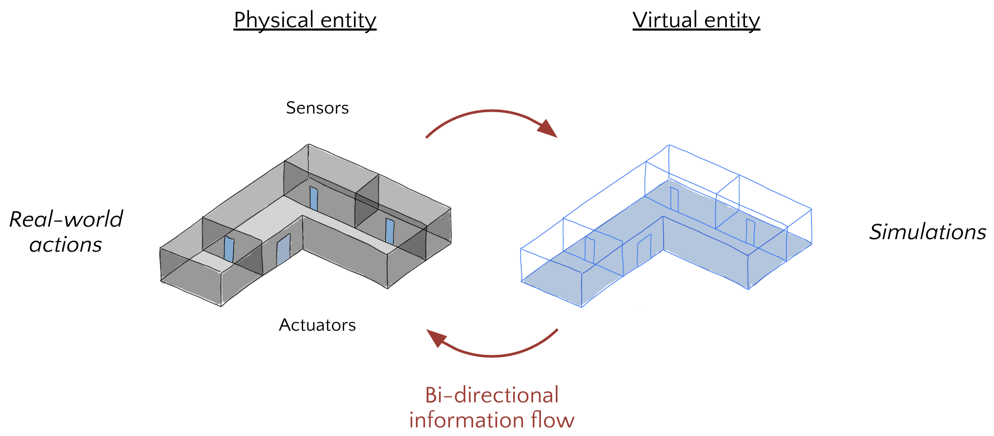
What are Digital Twins?

Slide 3
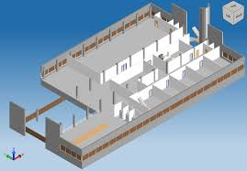
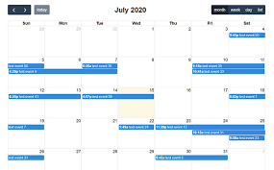


What are Digital Twins?

Slide 4
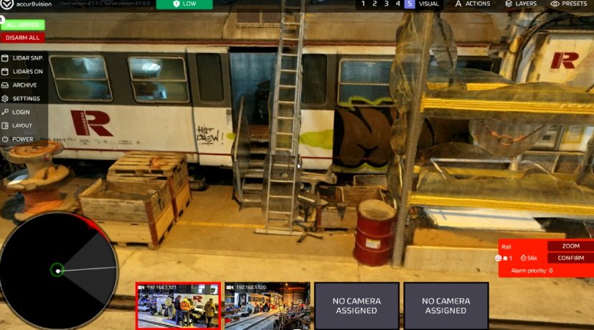
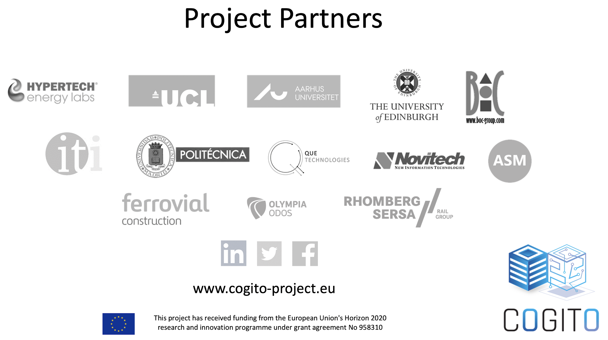
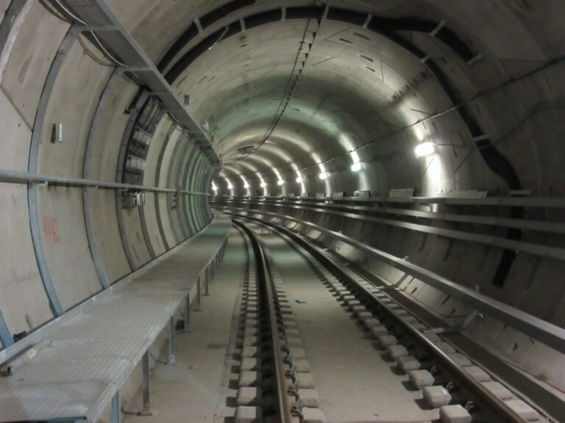
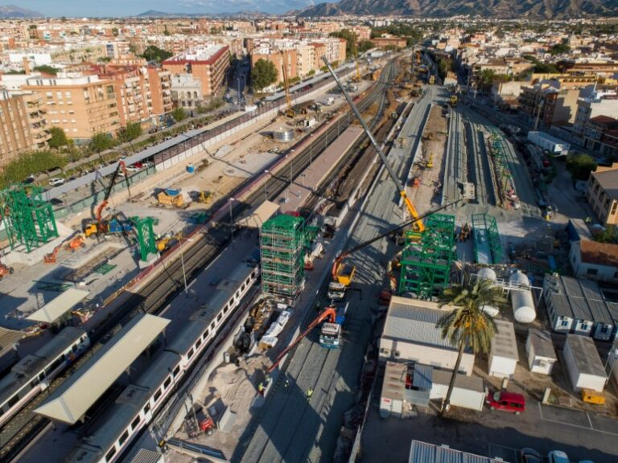
COGITO Project
COnstruction-phase diGItal Twin mOdel
Testlab - Austria
Pilot Site I - Denmark
Pilot Site II - Spain

Slide 5
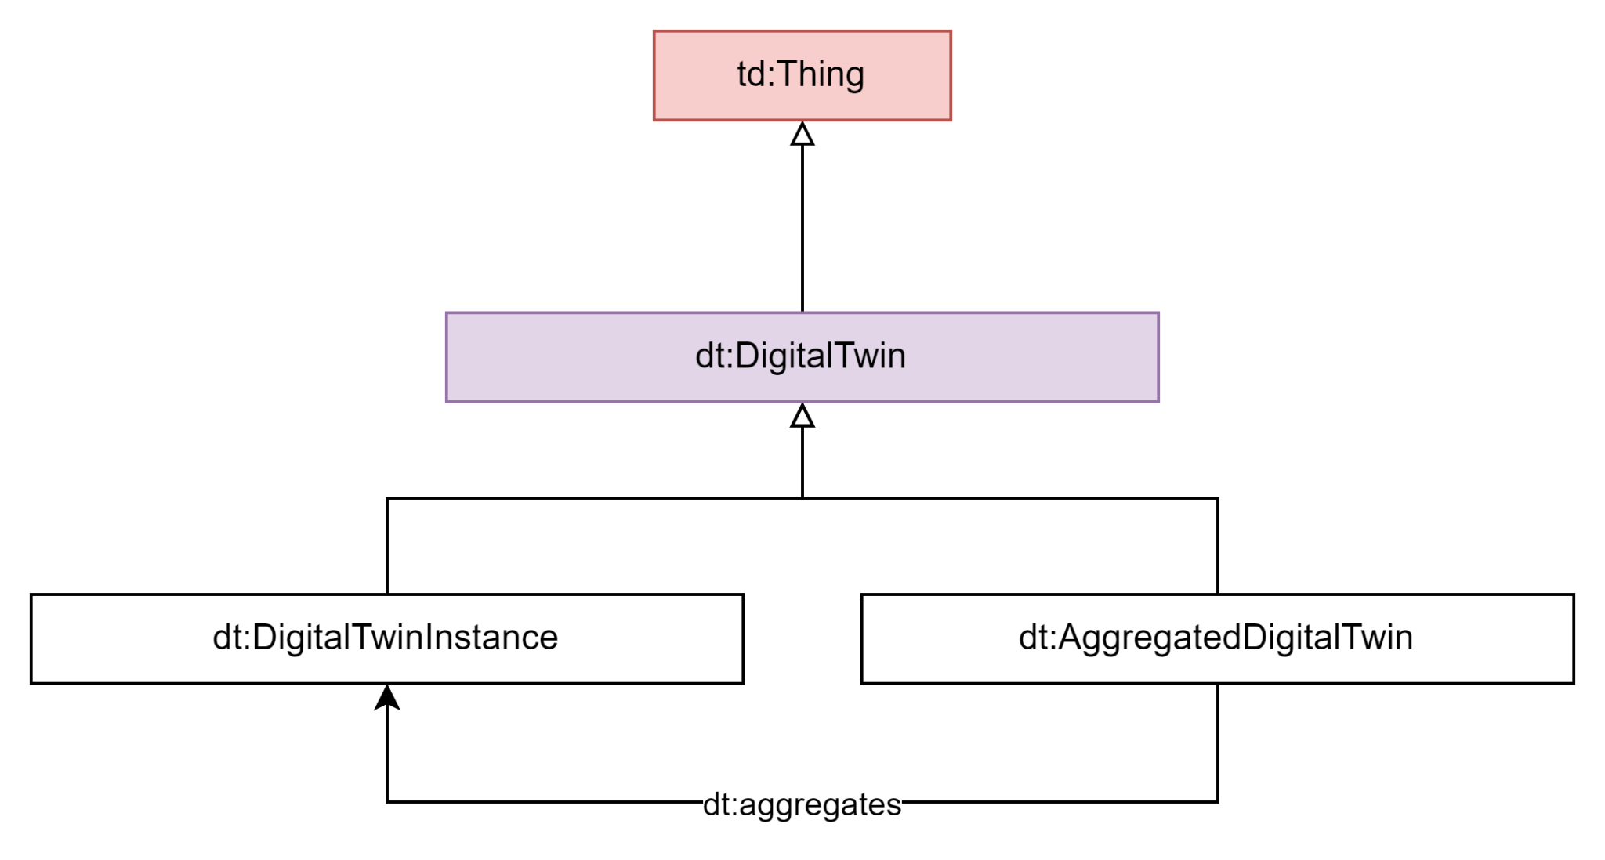
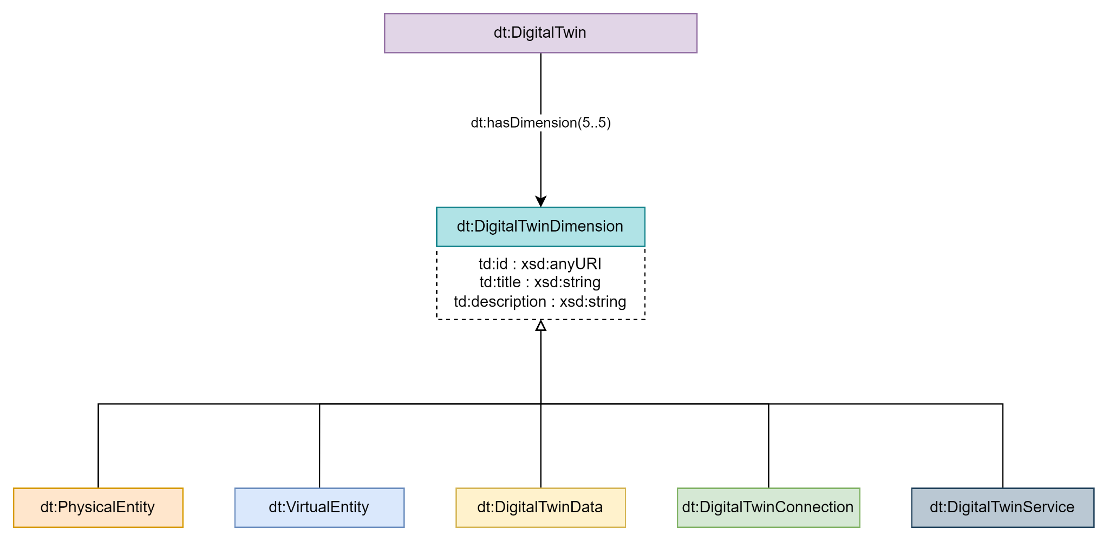
Ontology

Slide 6
Thing Description
{ "@context": [ "https://www.w3.org/2019/wot/td/v1", { "element": "https://data.cogito.iot.linkeddata.es/resources/element/", "sdt": "https://data.cogito.iot.linkeddata.es/resources/sdt/", "dt_pe": "https://data.cogito.iot.linkeddata.es/resources/pe/", "dt_ve": "https://data.cogito.iot.linkeddata.es/resources/ve/", "dt_dd": "https://data.cogito.iot.linkeddata.es/resources/dd/", "dt_cn": "https://data.cogito.iot.linkeddata.es/resources/cn/" }, "https://raw.githubusercontent.com/Salva5297/SemanticDT_TD/main/context/dt.td.context.jsonld", "https://w3c.github.io/wot-discovery/context/discovery-core.jsonld" ], "securityDefinitions": { "nosec_sc": { "scheme": "nosec" } }, "security": [ "nosec_sc" ], "id": "sdt:01U2Ox69TF78CjGAzXHALN", "type": "Semantic_Digital_Twin_Instance", "title": "Element 160035", "description": "Element 160035 from project b3fe643d-f9f2-4e14-bf3c-95343d63c850",
…

Slide 7
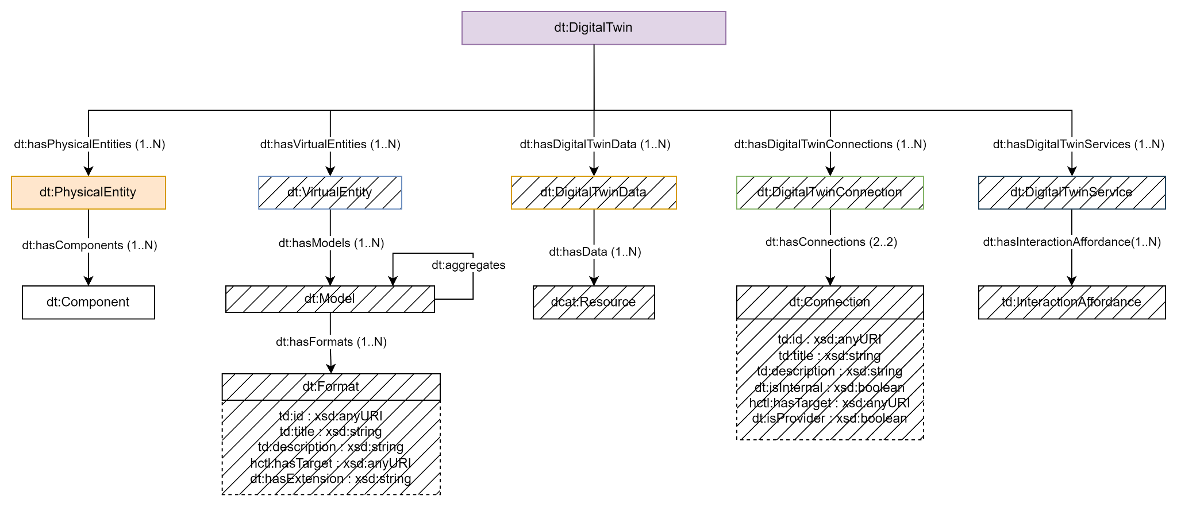
Ontology

Slide 8
DT Thing Description Extension Physical Entity
"pe": [ { "id": "dt_pe:01U2Ox69TF78CjGAzXHALN;1", "type": "Physical_Entity", "title": "Element 160035", "description": "Physical Entity Element 160035", "components": [ { "id": "01U2Ox69TF78CjGAzXHALN", "type": "IfcSlab.FLOOR", "title": "M_Pile-Steel Pipe:400mm Diameter:147737", "description": "A slab is a component of the construction that normally encloses a space vertically. The slab may provide the lower support (floor) or upper construction (roof slab) in any space in a building.", "href": "element:160035" } ] } ],

Slide 9
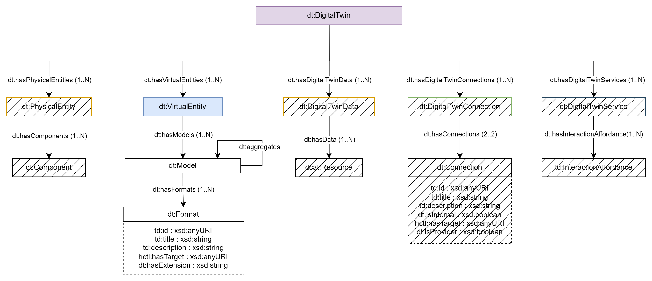
Ontology

Slide 10
DT Thing Description Extension Virtual Entity
"ve": [ { "id": "dt_ve01U2Ox69TF78CjGAzXHALN;1", "type": "Virtual_Entity", "title": "Virtual Entity", "description": "Virtual Entity of SDT 01U2Ox69TF78CjGAzXHALN from project b3fe643d-f9f2-4e14-bf3c-95343d63c850", "models": [ { "type": "Ontology_Model", "title": "Building Element Ontology", "description": "The Building Element Ontology provides an ontology based on the IfcBuildingElement subtree in the IFC specification, containing a taxonomy of classes that allow to define common building elements.", "formats": [ { "type": "Format", "title": "JSON-LD", "description": "JSON-LD format.", "href": "https://pi.pauwel.be/voc/buildingelement/ontology.json", "extension": "json" }, { "type": "Format", "title": "RDF/XML", "description": "RDF/XML Format.", "href": "https://pi.pauwel.be/voc/buildingelement/ontology.xml", "extension": "xml" },
…

Slide 11
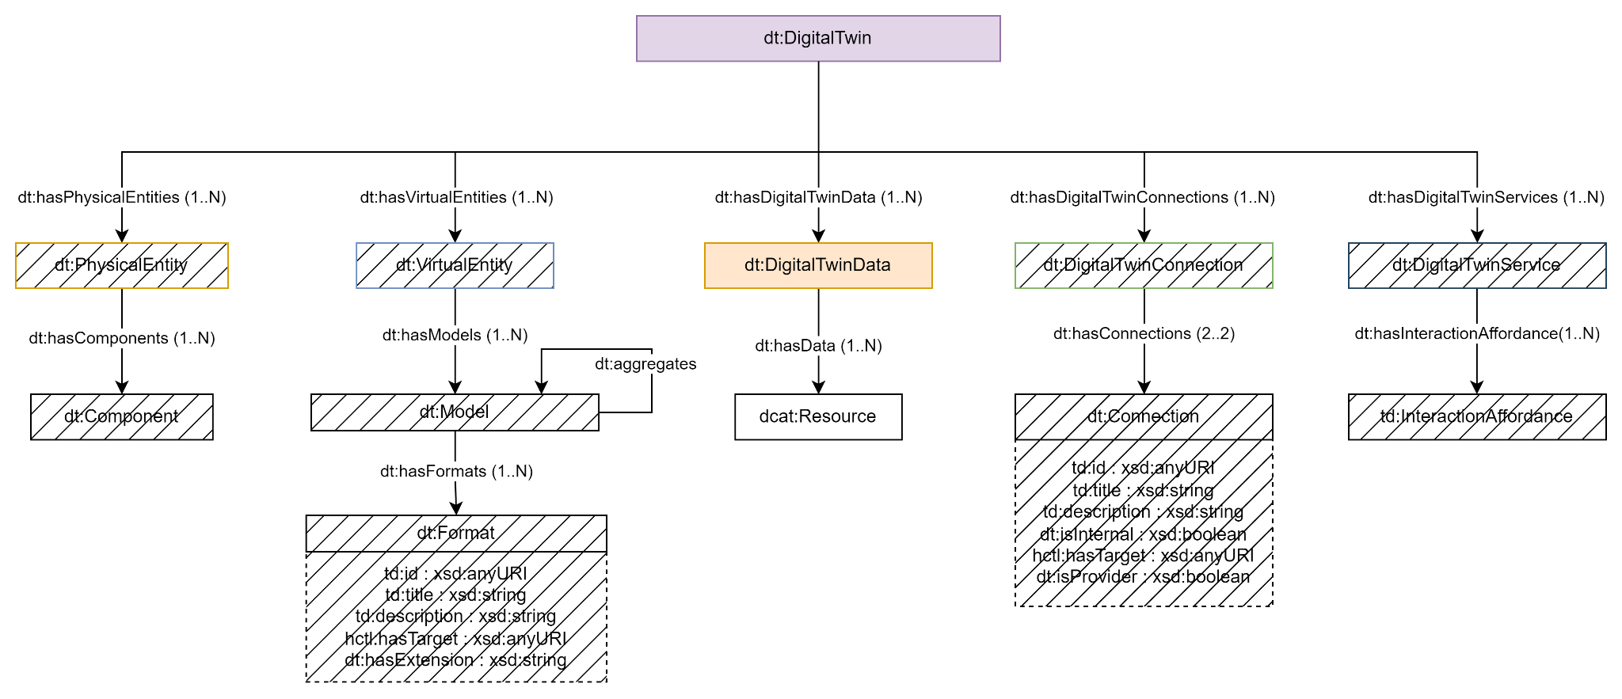
Ontology

Slide 12
DT Thing Description Extension Digital Twin Data
"dd": [
{
"id": "dt_dd:01U2Ox69TF78CjGAzXHALN;1",
"type": "Digital_Twin_Data",
"title": "Digital Twin Data",
"description": "Digital Twin Data of SDT 01U2Ox69TF78CjGAzXHALN from project b3fe643d-f9f2-4e14-bf3c-95343d63c850.",
"data": [
{
"type": "dcat:Dataset",
"title": "Knowledge Graph",
"description": "Knowledge Graph of SDT 01U2Ox69TF78CjGAzXHALN from project b3fe643d-f9f2-4e14-bf3c-95343d63c850.",
"dcat:distribution": {
"dcat:accessURL": "https://data.cogito.iot.linkeddata.es/beo_bot_ifc",
"dcat:mediaType": "application/sparql-results+json",
"dcat:downloadURL": "https://triplestore.cogito.iot.linkeddata.es/rest/explore/graph?uri=https%3A%2F%2Fdata.cogito.iot.linkeddata.es%2Fbeo_bot_ifc&role=context&inference=all&bnodes=true&sameAs=true",
"dcat:accessService": {
"dcat:endpointURL": "https://triplestore.cogito.iot.linkeddata.es/repositories/demo",
"dcat:endpointDescription": "SPARQL endpoint of the Triplestore where the Knowledge Graph is stored."
}
}
},
…

Slide 13
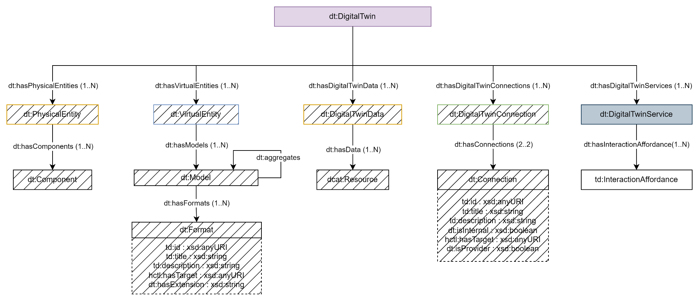
Ontology

Slide 14
DT Thing Description Extension Digital Twin Services
"ss": [
{
"id": "dt_ss:01U2Ox69TF78CjGAzXHALN;1",
"type": "Digital_Twin_Service",
"title": "Digital Twin Service RDF validator",
"description": "Digital Twin Service RDF validator of SDT 01U2Ox69TF78CjGAzXHALN from project b3fe643d-f9f2-4e14-bf3c-95343d63c850.",
"interaction_affordances": {
"properties": {
"validate_rdf": {
"forms": [{
"href": "https://data.cogito.iot.linkeddata.es/validation/api/validate_rdf/data",
"type": "text/turtle"
}]
}
},
"actions": {
"register_shacl_model": {
"forms": [{
"href": "https://data.cogito.iot.linkeddata.es/validation/api/rdf_shacl/mapping",
"type": "application/octet-stream"
}]
}
},
"events": {},
"links": []
}
},
…

Slide 15
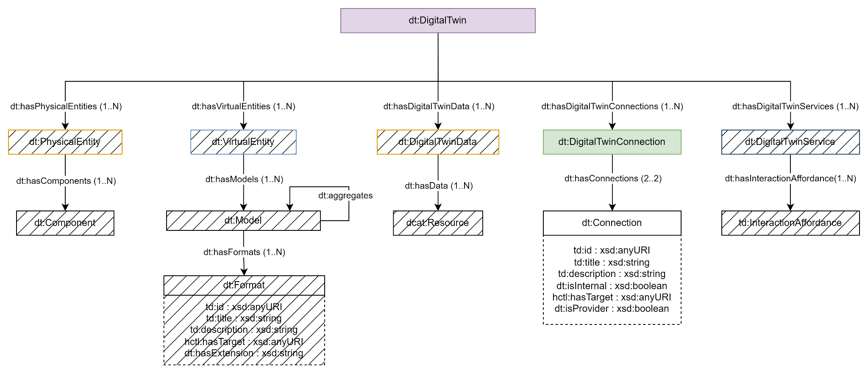
Ontology

Slide 16
DT Thing Description Extension Digital Twin Services
"cn": [ { "id": "dt_cn:01U2Ox69TF78CjGAzXHALN;1", "type": "Digital_Twin_Connection", "title": "Digital Twin Connection 1", "description": "Digital Twin Connection 1 of SDT 01U2Ox69TF78CjGAzXHALN from project b3fe643d-f9f2-4e14-bf3c-95343d63c850.", "connections": [ { "type": "Digital_Twin_Service", "title": "Helio", "description": "Materialization service used to generate RDF data.", "href": "https://data.cogito.iot.linkeddata.es/validation/api/project_to_rdf/data", "provider": "false", "internal": "true" }, { "type": "dcat:Dataset", "title": "IFC File", "description": "IFC File of SDT 01U2Ox69TF78CjGAzXHALN from project b3fe643d-f9f2-4e14-bf3c-95343d63c850.", "href": "https://dtp.cogito-project.com/file/508bfae6-dada-46d1-8d40-beb18c1619b8/download", "provider": "true", "internal": "false" } ] },
…

Slide 17
W3C WoT Meeting
Digital Twin Thing Descriptions
Ontology Engineering Group,
Universidad Politécnica de Madrid
Salvador González Gerpe, Andrea Cimmino,
Raúl García-Castro
salvador.gonzalez.gerpe@upm.es
10/2023

Slide 18
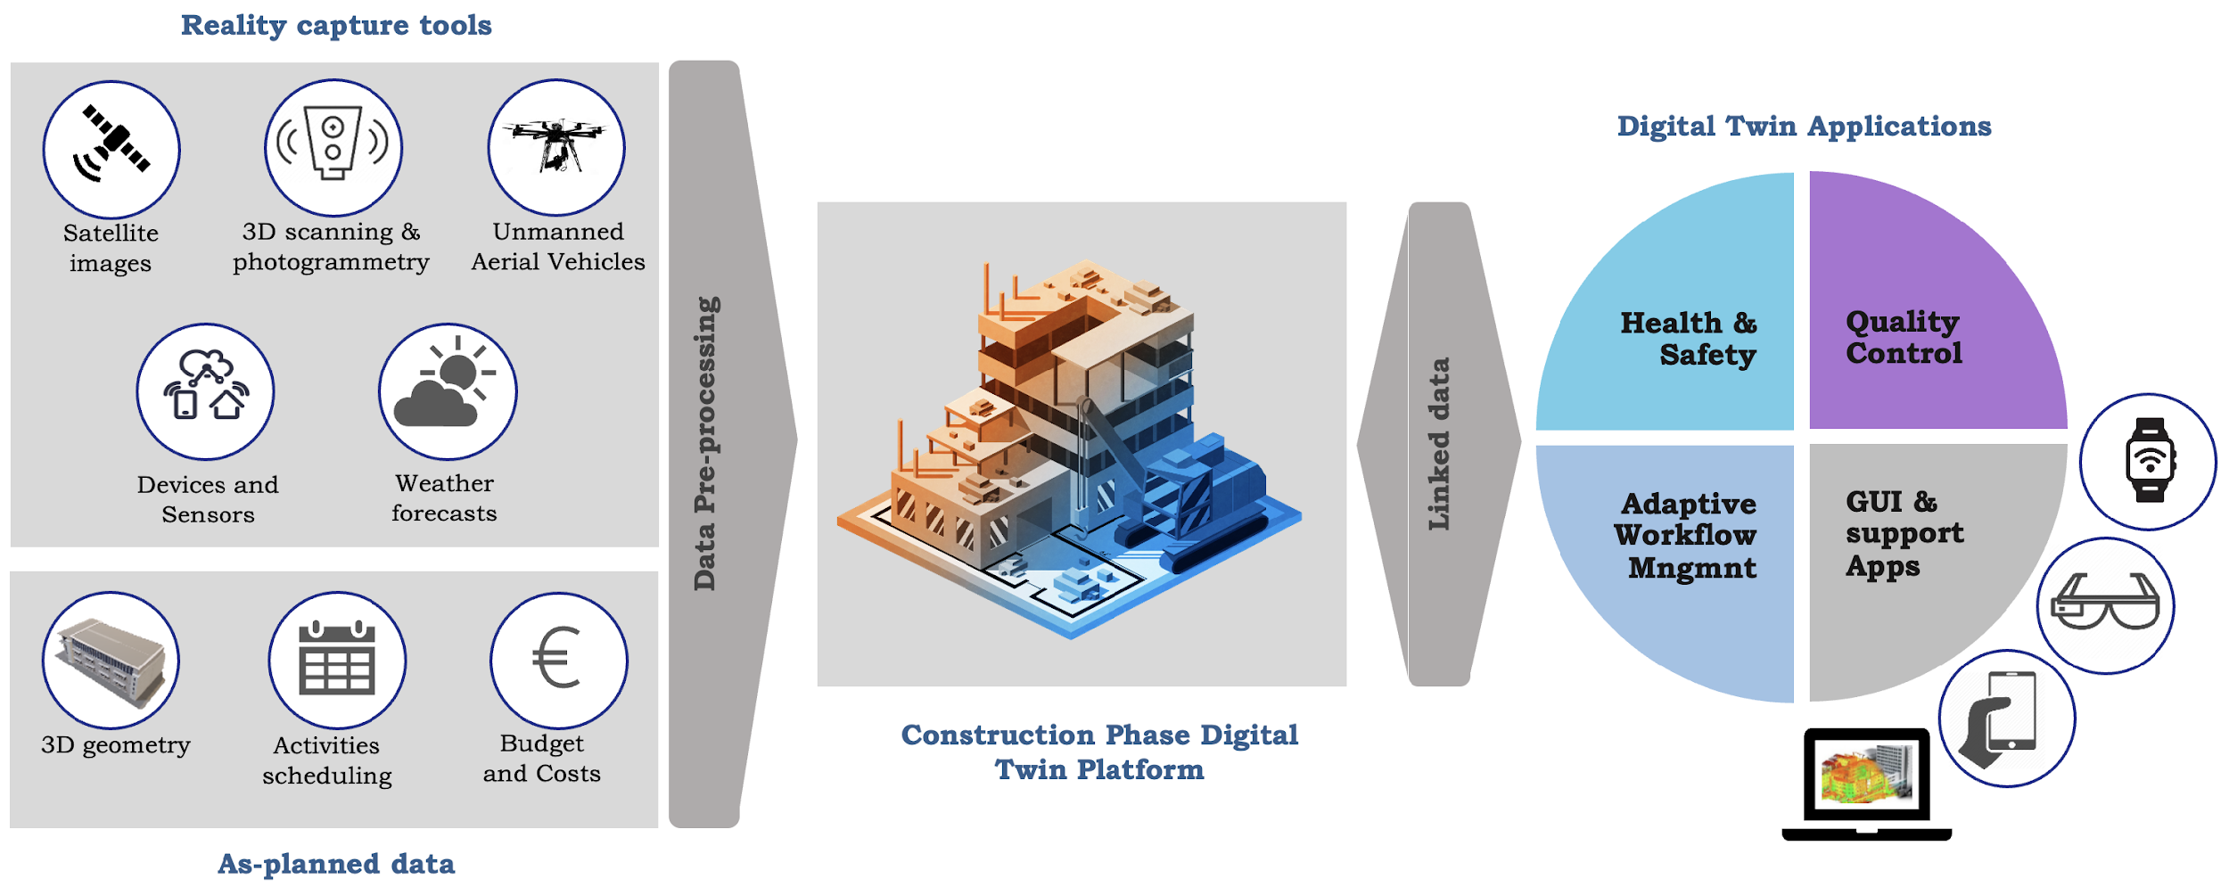

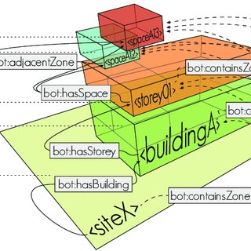



COGITO Project
OPEN STANDARDS
SAREF
BOT
BRICK

Slide 19
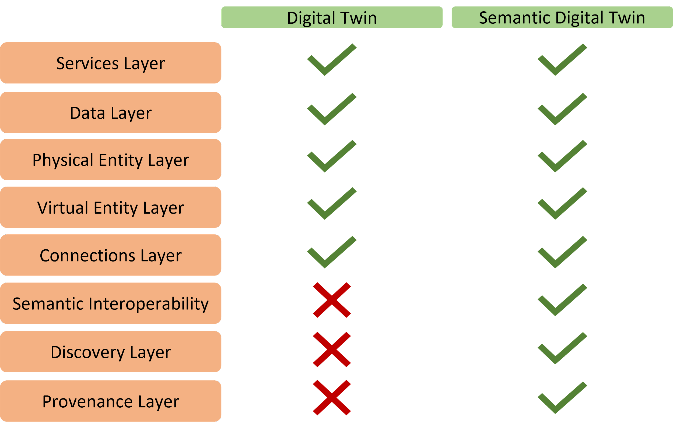
Semantic Digital Twin

Slide 20

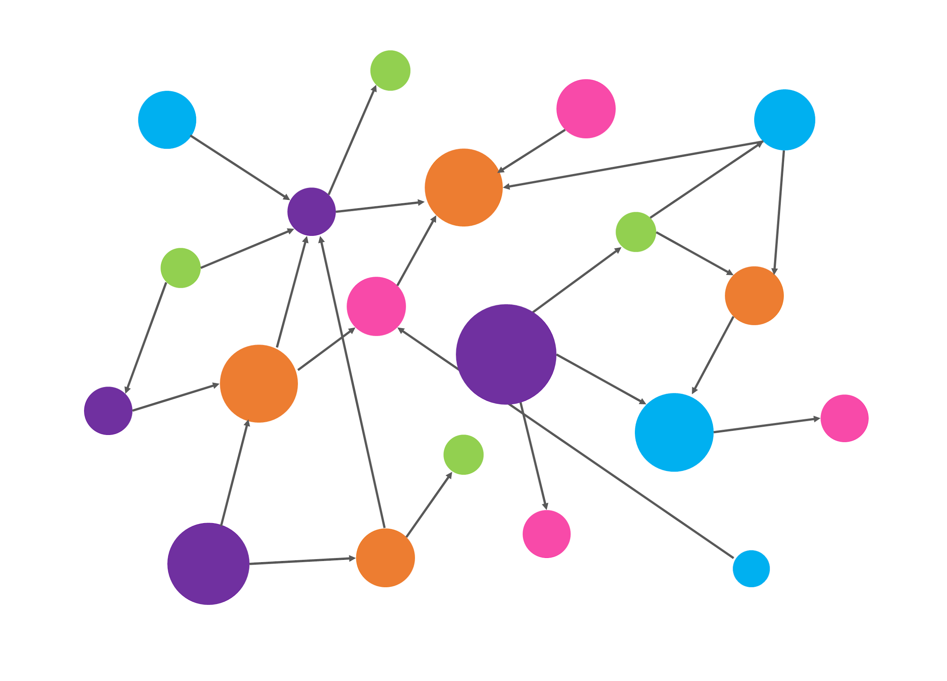

Data distribution in COGITO Semantic Digital Twin
Relational DB
(Project Data)
Key-Value DB
(IFC Data)
Timeseries DB
(IoT Data)
BIM Data Post-processing Services
Triplestore DB
(Semantically Linked Data; RDF)
Extraction, Transformation &
Loading Services
Data Management Services

Slide 21




Semantic Interoperability in Digital Twins
Services
Heterogeneous Data
Homogeneous Data
Data
Ontology
Virtual Entity
Physical Entity
Data Harmonization
Data Enrichment
Connections
Semantic Model
Heterogeneous Data
Homogeneous Data
Provenance

Slide 22
Semantic Interoperability in Digital Twins
Services
Heterogeneous Data
Homogeneous Data
Data
Ontology
Virtual Entity
Physical Entity
Data Harmonization
Data Enrichment
Connections
Semantic Model
Heterogeneous Data
Homogeneous Data
Provenance

Slide 23
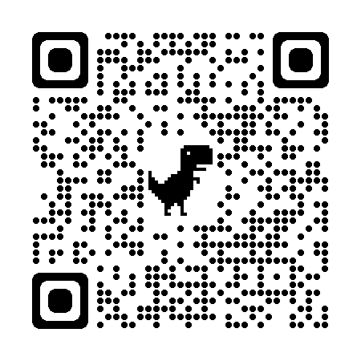
COGITO ontologies classes described as Digital Twins
COGITO Ontologies
Facility
Resources
Process
?
Digital Twin
Quality
Safety
IoT
Notes:
What kind of data decrypted in the ontologies can be represented as Digital Twins

Slide 24
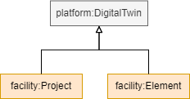
COGITO ontologies classes described as Digital Twins
COGITO Ontologies
Facility
Resources
facility:Project
facility:Element
Process
Digital Twin
Quality
Safety
IoT
Notes:
Los facility:Project y los facility:Element serán los clases en este proyecto que serán representadas como Digital Twins.

Slide 25
COGITO Ontology extension
COGITO Ontologies
Facility
Resources
Process
Platform
W3C Thing Description ontology
Quality
Safety
IoT
Notes:
Con el objetivo de no perder el provenance en el Semantic Digital Twin, se ha procedido a definir cada Digital Twin como un td:Thing, referente a la ontología perteneciente a los Thing Descrptions. Para ello se ha creado una extensión en las ontologías que describe los datos descritos como Digital Twins, como td:Things con el objetivo de poder definir los Digital Twins como Thing Descriptions. La extensión de estas ontologías se ha definido como Platform.

Slide 26
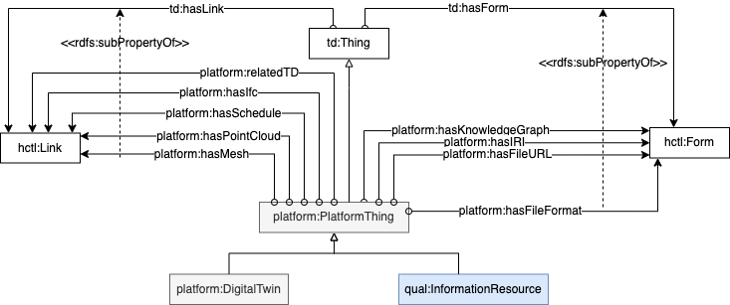
COGITO Platform Ontology

Slide 27
COGITO Semantic Digital Twin backbone based on WoT
Relational DB
(Project Data)
Key-Value DB
(IFC Data)
Timeseries DB
(IoT Data)
BIM Data Post-processing Services
Triplestore DB
(Semantically Linked Data; RDF)
Extraction, Transformation &
Loading Services
Data Management Services

Slide 28



COGITO Semantic Digital Twin backbone based on WoT
Query
Discovery
Semantic DT Components

Slide 29

Conclusions
Digital Twins have lots of data and has to be handled.
The development of a Semantic Digital Twin allows the management of all data to be semantically interoperable.
In order to not lose the heterogeneous data belonging to the main entities described as Digital Twins, a WoT-based backbone has been developed, allowing the maintenance of the provenance belonging to all the data of the defined Digital Twin.
In addition, thanks to the WoT layer given by the Thing Descriptions, discovery can be performed in order to obtain all the information concerning a particular Digital Twin in a more straightforward form.

